Slide 2
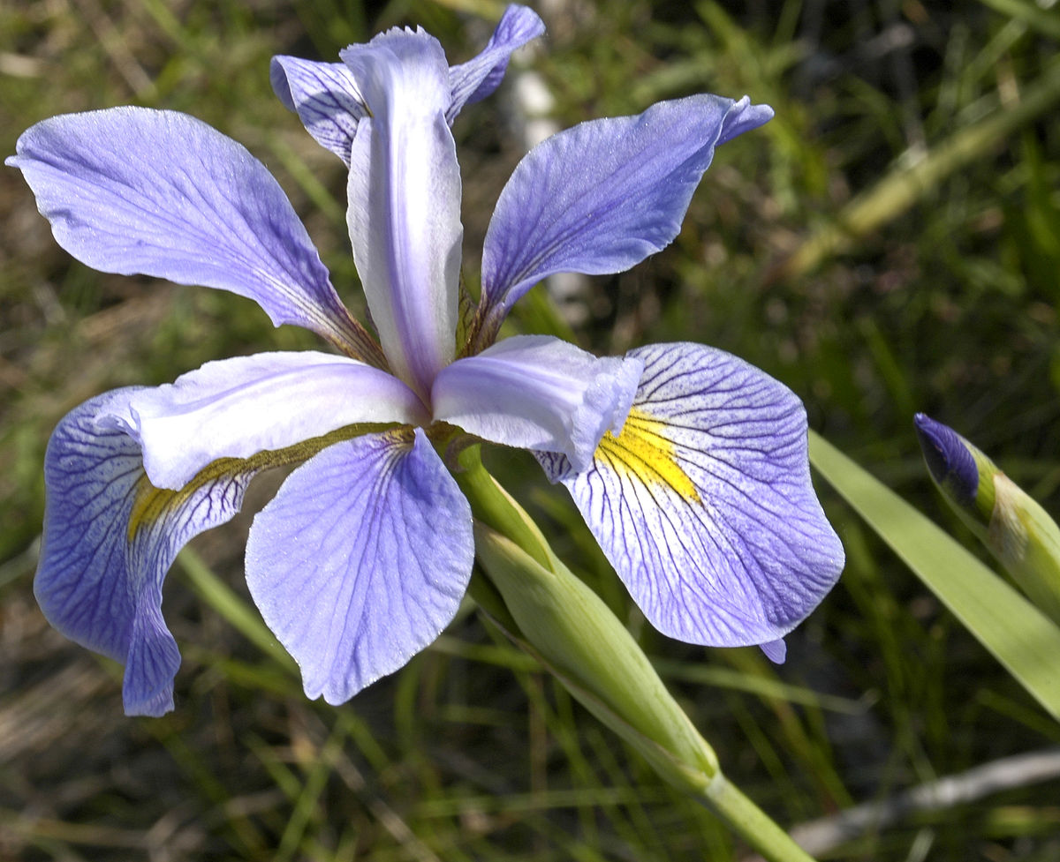
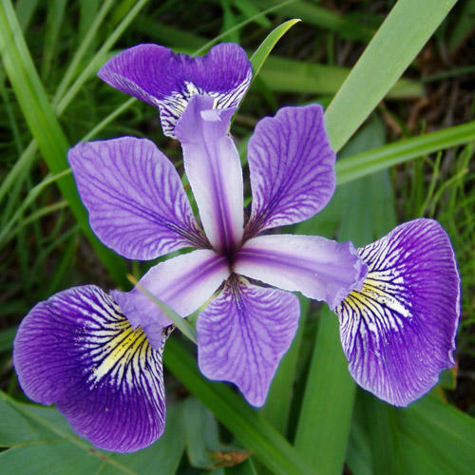
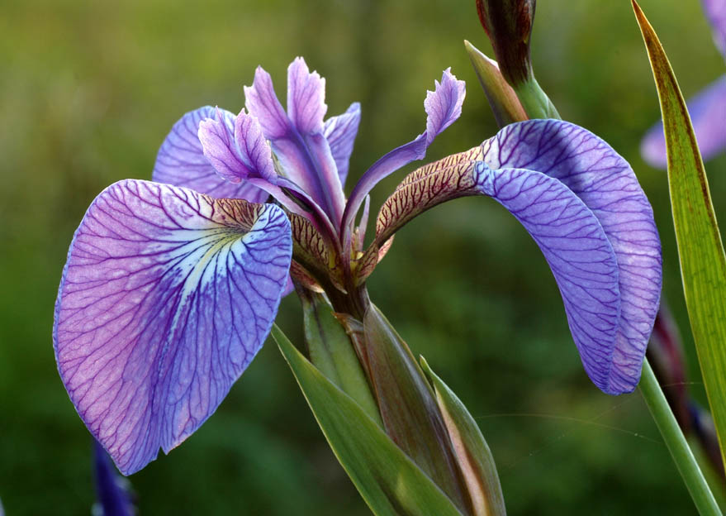
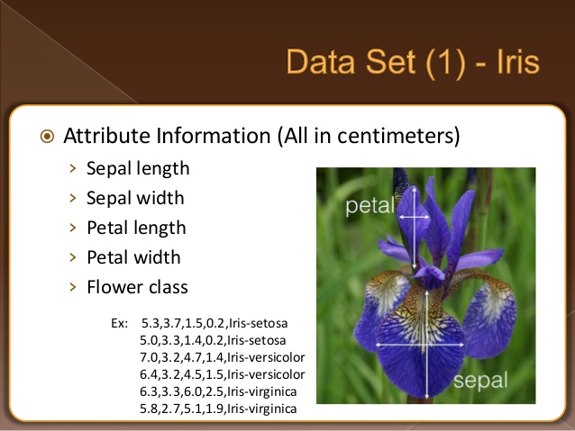
IRIS VIRGINICA
IRIS VERSICOLOR
IRIS SETOSA

Slide 3
TRAINING PHASE: The Neural Network will learn from 100 samples like this:
Sepal Length | Sepal Width | Petal Length | Petal Width | Iris Species
6.8 | 2.8 | 4.8 | 1.4 | versicolor
4.8 | 3.0 | 1.4 | 0.3 | setosa
6.1 | 2.9 | 4.7 | 1.4 | versicolor
5.8 | 2.7 | 5.1 | 1.9 | virginica
TESTING PHASE: The Neural Network will be tested with 50 samples like this.
Sepal Length | Sepal Width | Petal Length | Petal Width | Iris Species
5.0 | 3.4 | 1.5 | 0.2 | ?
5.6 | 3.0 | 4.5 | 1.5 | ?
5.9 | 3.2 | 4.8 | 1.8 | ?
6.7 | 3.3 | 5.7 | 2.1 | ?
As we know the correct Iris Species for each sample, we will compare the Neural Network output with the correct answer.

Slide 4
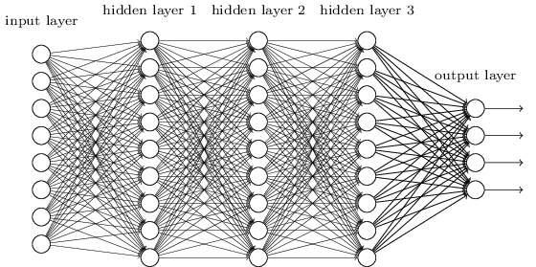
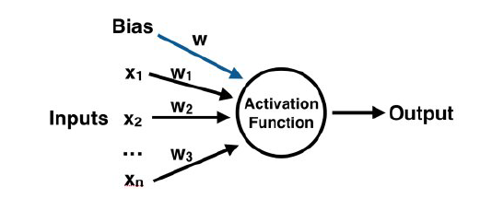
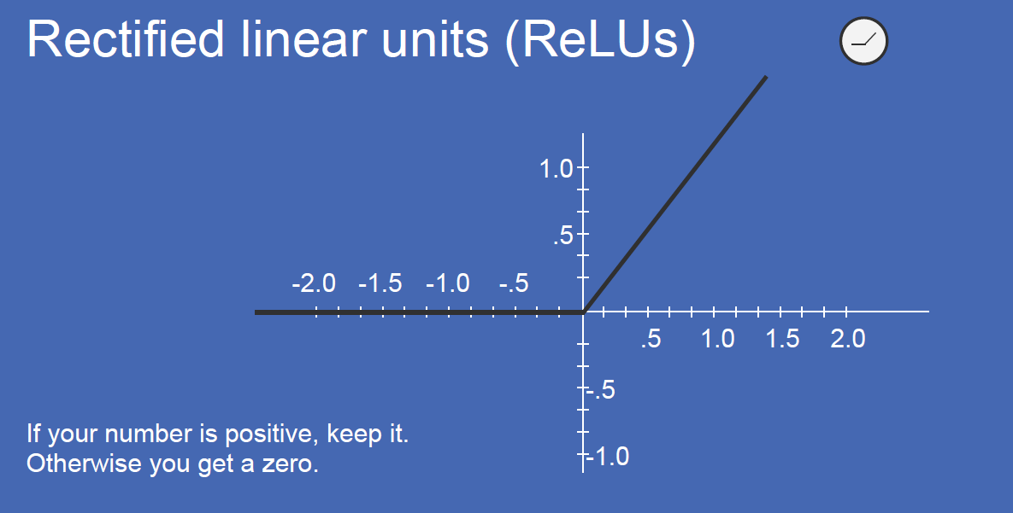
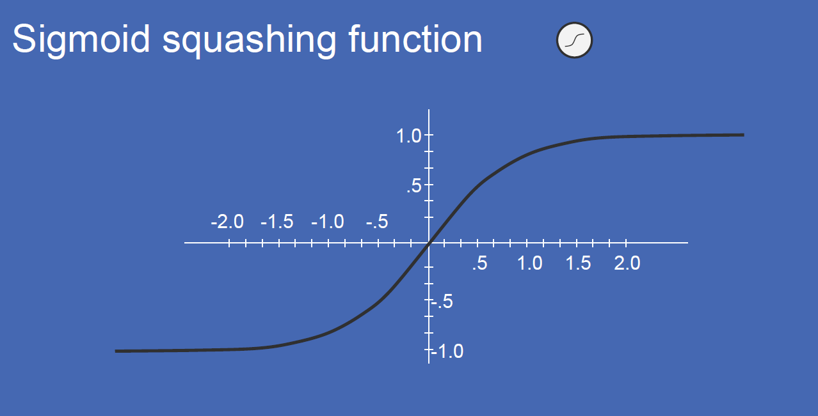
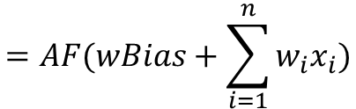
Example of Neural Network
Structure and Operation of the single Neural Node
AF()
$$=AF(wBias+\sum_{i=1}^{n}{w_{i}x_{i}})$$
Each Neural Node calculates a linear weigthed combination of the inputs plus an arbitrary number called bias. This sum is processed by a nonlinear function called Activation Function, see below two exampled of Activation Function.
Example of a Neural Network with three Hidden Layers
Examples of Activation Functions AF()

Slide 5
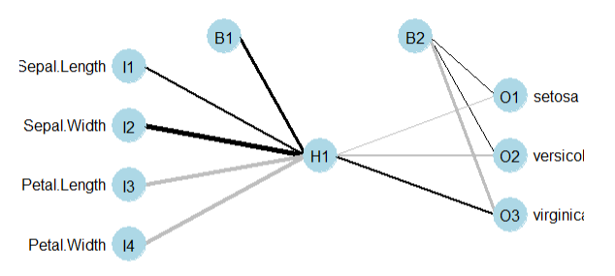
Initial random Neural Network
Output vs Correct Results
0.1
 | Setosa | Versicolor | Virginica
O1 Setosa | 14 Correct | 13 Wrong | 23 Wrong
O2 Versicolor
O3 Virginica
0.4
0.3
-0.1
0
0.6
-0.2
Testing Data
50 cases
-0.4
-0.6
-0.6
0.2
The untrained network is providing alway Setosa as results. The Correct Result was Setosa In 14 cases, Versicolor 13 cases and Virginica 23 cases.
The resulting accuracy is 28%

Slide 6
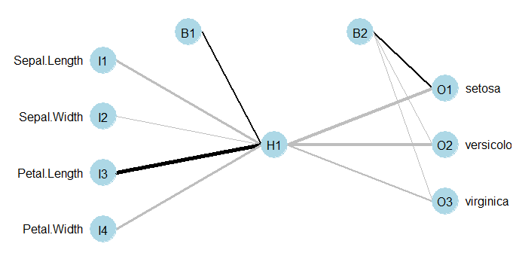
Neural Network after one training cycle
Output vs Correct Results
0.3
 | Setosa | Versicolor | Virginica
O1 Setosa | 14 Correct | 13 Wrong | 23 Wrong
O2 Versicolor
O3 Virginica
0.4
-0.5
-0.7
0
-0.3
-0.6
Testing Data
50 cases
0.8
-0.2
-0.4
-0.5
After one cycle training the network is providing alway Setosa as results. The Correct Result was Setosa In 14 cases, Versicolor 13 cases and Virginica 23 cases.
The resulting accuracy is 28%

Slide 7
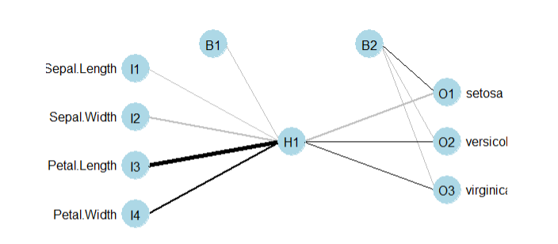
Neural Network after multiple training cycles
Output vs Correct Results
9
 | Setosa | Versicolor | Virginica
O1 Setosa | 14 Correct
O2 Versicolor |  | 13 Correct | 23 Wrong
O3 Virginica
-5.5
-5.2
-19
-5
-21
9.6
Testing Data
50 cases
45
-3.4
7.7
20
After several cycles training the network is providing Setosa and Versicolor results. The Setosa was correctly classified, While Versicolor was correctly classified 13 times and 23 times was wrong.
The resulting accuracy is 54%

Slide 8
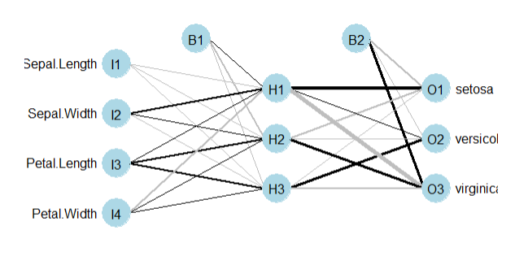
Neural Network with three nodes in the hidden layer
Output vs Correct Results
 | Setosa | Versicolor | Virginica
O1 Setosa | 14 Correct
O2 Versicolor |  | 11 Correct
O3 Virginica |  | 2 Wrong | 23 Correct
Testing Data
50 cases
The three hidden nodes Network is providing wrong result in two cases only where two Versicolor was classified Virginica.
The resulting accuracy is 96%

Slide 9
1
1
w6
Setosa
Sepal Length
w8
w1
w5
w9
w7
Sepal Width
w2
w10
Versicolor
Petal Length
w3
w4
w11
Petal Width
Virginica

Slide 10

